Slide 1
FEATURES OF MODERN OBJECT ORIENTED LANGUAGES
  Guided By – Shital Dongre Ma'am
    18 - Abhijit Gawai
    29 - Shyam Kawale
    43 - Nishant Bhat
    50 - Bhargav Pawar
    55 - S. Abhishek

Slide 2
CONTENTS
STANDARD OOPS FEATURES
REFLECTION
REAL USES OF REFLECTION
C# DELEGATES WITH EXAMPLES
EXTENSION METHODS
INTERFACE DEFAULT METHODS
LAMBDA IN C#
ANONYMOUS TYPE IN C#

Slide 3
STANDARD OOPS FEATURES
Abstraction: Abstraction is the concept of object-oriented programming that shows only essential attributes and hides unnecessary information.
Encapsulation: In object-oriented programming, encapsulation refers to the bundling of data with the methods that operate on that data, or the restricting of direct access to some of an object's components.
Inheritance: Inheritance is one of the core concepts of object-oriented programming languages. It is a mechanism where you can to derive a class from another class for a hierarchy of classes that share a set of attributes and methods.
Polymorphism: Polymorphism is the method in an object-oriented programming language that performs different things as per the object's class, which calls it.

Slide 4
REFLECTION
In computer science, reflective programming or reflection is the ability of a process to examine, introspect, and modify its own structure and behavior.
Reflection provides objects (of type Type) that describe assemblies, modules, and types.
You can use reflection to dynamically create an instance of a type, bind the type to an existing object, or get the type from an existing object and invoke its methods or access its fields and properties.
If you are using attributes in your code, reflection enables you to access them.
int i =42;
System.type type= i.GetType();
System.Console.WriteLine(type);

Slide 5
REAL USES OF REFLECTION
Code Analyser Tools.
Eclipse auto completion of method names.
Marshalling and unmarshalling.
Spring Framework for creating the beans.
Parsing annotations by ORMs like hibernate entity
Junit Testcases

Slide 6
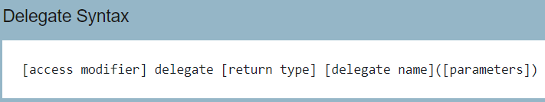
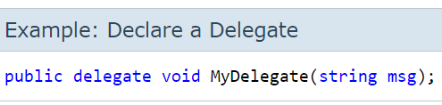
C# Delegates
Delegate is a object to refer method
Steps of Delegate
  Declare a delegate
  Set a target method
  Invoke a delegate

Slide 7
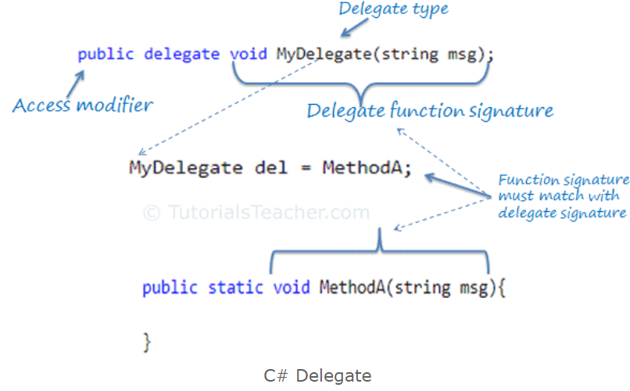
C# Delegate
Declare
Set Target Method
Invoke

Slide 8
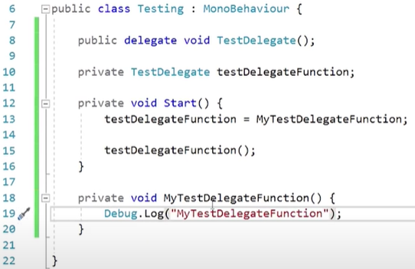
Delegate Example
Example
Declare
Set Target Method
Invoke
OUTPUT - MyTestDelegateFunction

Slide 9
EXTENSION METHODS
Extension methods allows developers to extend functionality of an existing type without creating a new derived type, recompiling, or otherwise modifying the original type.
C# extension method is a static method of a static class, where the "this" modifier is applied to the first parameter.
The type of the first parameter will be the type that is extended.
class ExtensionMethods2 {
static void Main() {
int[] ints = { 10, 45, 15, 39, 21, 26 };
var result = ints.OrderBy(g => g);
foreach (var i in result) {
System.Console.Write(i + " "); } } }

Slide 10
EXTENSION METHODS EXAMPLE
namespace ExtensionMethods {
public static class MyExtensions {
public static int WordCount(this String str) {
return str.Split(new char[] { ' ', '.', '?' },
StringSplitOptions.RemoveEmptyEntries).Length; } } }
using ExtensionMethods;
string s = "Hello Extension Methods"; int i = s.WordCount();

Slide 11
Interface Default Methods
Java 8 introduces the “Default Method” or (Defender methods) feature, which allows the developer to add new methods to the interfaces without breaking their existing implementation.
It provides the flexibility to allow interface to define implementation which will use as the default in a situation where a concrete class fails to provide an implementation for that method.
Example:-
public interface oldInterface {
public void existingMethod();
default public void newDefaultMethod() {
System.out.println("New default method is added in interface");
}
}
public class oldInterfaceImpl implements oldInterface {
public void existingMethod() {
// existing implementation is here…
}}
oldInterfaceImpl obj = new oldInterfaceImpl ();
// print “New default method add in interface”
obj.newDefaultMethod();

Slide 12
LAMBDA IN C#
Lambda Expression is a shorter way of representing anonymous method.
General Method –
  function(Student s) { return s.Age > 12 && s.Age < 20; };
Lambda expression syntax: parameter => body expression
  s => s.Age > 12 && s.Age < 20
Lambda Expression can have zero parameter.
  () => Console.WriteLine("Parameter less lambda expression")
Lambda Expression can have multiple parameters in parenthesis ().
  (s, youngAge) => s.Age >= youngage;
Lambda Expression can be assigned to Function.

Slide 13
ANONYMOUS TYPE IN C#
An anonymous type is a type (class) without any name that can contain public read-only properties only. It cannot contain other members, such as fields, methods, events, etc.
Creation –
  You create an anonymous type using the new operator with an object initializer syntax.
  var student = new { Id = 1, FirstName = “Abhishek", LastName = “S" };
var students = new[] {
new { Id = 1, FirstName = “Abhi", LastName = “G" },
new { Id = 2, FirstName = "Shyam", LastName = “K" },
new { Id = 3, FirstName = “Nishant", LastName = “Bhat" }
};

Slide 14
PROPERTIES
The properties of anonymous types are read-only and cannot be initialized with a null, anonymous function, or a pointer type.
The properties can be accessed using dot (.) notation, same as object properties.
var student = new { Id =1,FirstName =“Abhishek",LastName =“S" };
Console.WriteLine(student.Id); //output: 1
student.Id = 2 //Error: cannot change value
An anonymous type will always be local to the method where it is defined.
Anonymous types are created using the Select clause of a LINQ queries to return a subset of the properties from each object in the collection.
  var students = from s in studentList
  select new { Id = s.StudentID, Name = s.StudentName };
Anonymous types are a feature of C#3.0, Visual Basic .NET 9.0 , Oxygen Scala and Go.

Slide 15
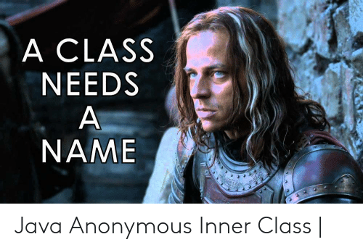
Anonymous Class in JAVA
One of the type of Inner Class.
It has no Name (name is decided by Java compiler at compile time). Class for which only single object is created.
Main purpose of Anonymous Class is to override method of a class or Interface.
Anonymous inner class are mainly created in two ways:
  Class
  Interface.
class outerClass {
// defining anonymous class
AnyClass object1 = new AnyClass( ) {
// body of the anonymous class
};
}
Syntax of Anonymous Class in JAVA

Slide 16
Example of Anonymous class
class Polygon {
public void display() {
System.out.println("Inside the Polygon class");
}
}
class AnonymousDemo {
public void createClass() {
// creation of anonymous class extending class Polygon
Polygon p1 = new Polygon() {
public void display() {
System.out.println("Inside an anonymous class.");
}
};
p1.display();
}
}
OUTPUT : Inside an anonymous class.

Slide 17
Dynamic type in C#
In computer science, a dynamic programming language is a class of high-level programming languages, which at runtime execute many common programming behaviors that static programming languages perform during compilation.
These behaviors could include an adding new code, by extending objects and definitions, or by modifying the type system.
Examples of Dynamic Programming Languages:
C++20, C#, COBOLSCRIPT, JULIA, PHP, Python etc.
C# 4.0 (.NET 4.5) introduced a new type called dynamic that avoids compile-time type checking. A dynamic type escapes type checking at compile-time; instead, it resolves type at run time.

Slide 18
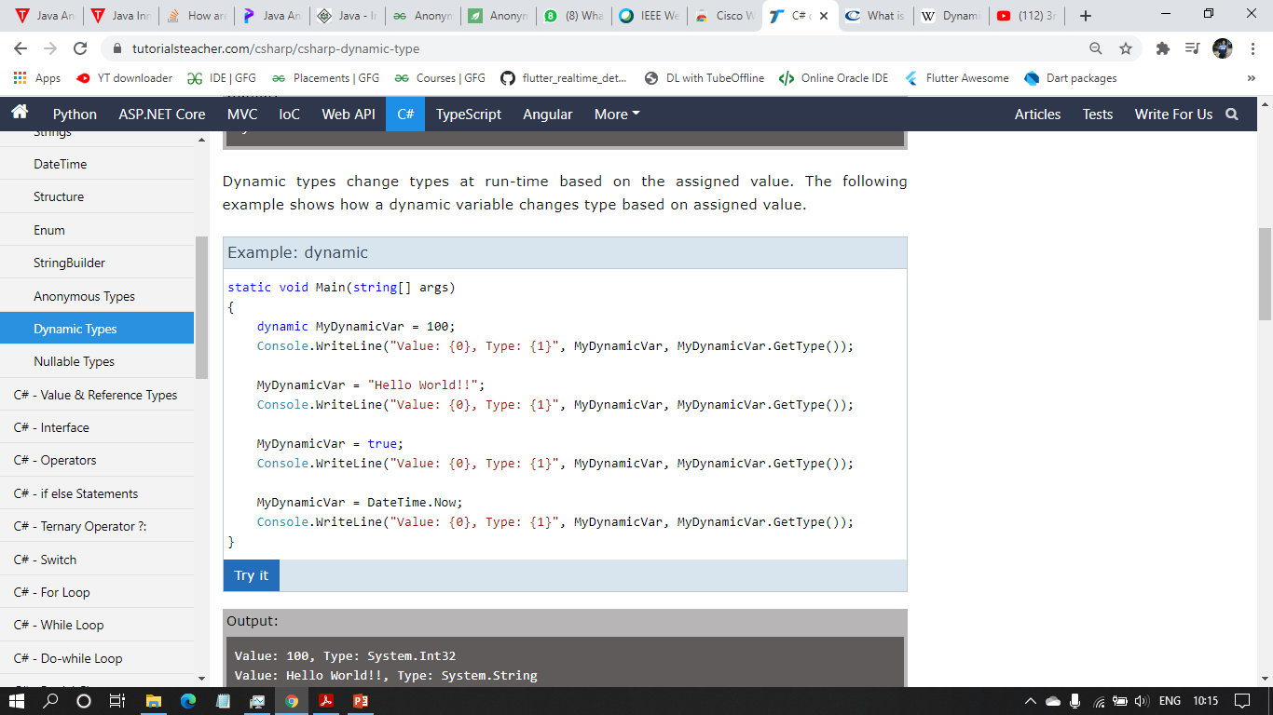
Dynamic Type contd.
Declaration of Dynamic Type Variable
dynamic MyDynamicVar = 1; Variable type: System.Int32
Example of Dynamic Type Variable:
OUTPUT:
Value: 100, Type: System.Int32
Value: Hello World!!, Type: System.String
Value: True, Type: System.Boolean
Value: 01-01-2014, Type: System.DateTime

Slide 19
REFERENCES
https://www.tutorialsteacher.com/linq/linq-lambda-expression
https://www.tutorialsteacher.com/csharp/csharp-anonymous-type
https://docs.microsoft.com/en-us/dotnet/csharp/programming-guide/classes-and-structs/extension-methods
https://dzone.com/articles/interface-default-methods-java#:~:text=Default%20methods%20can%20be%20provided,implementation%20provided%20by%20the%20interface

